Slide 1
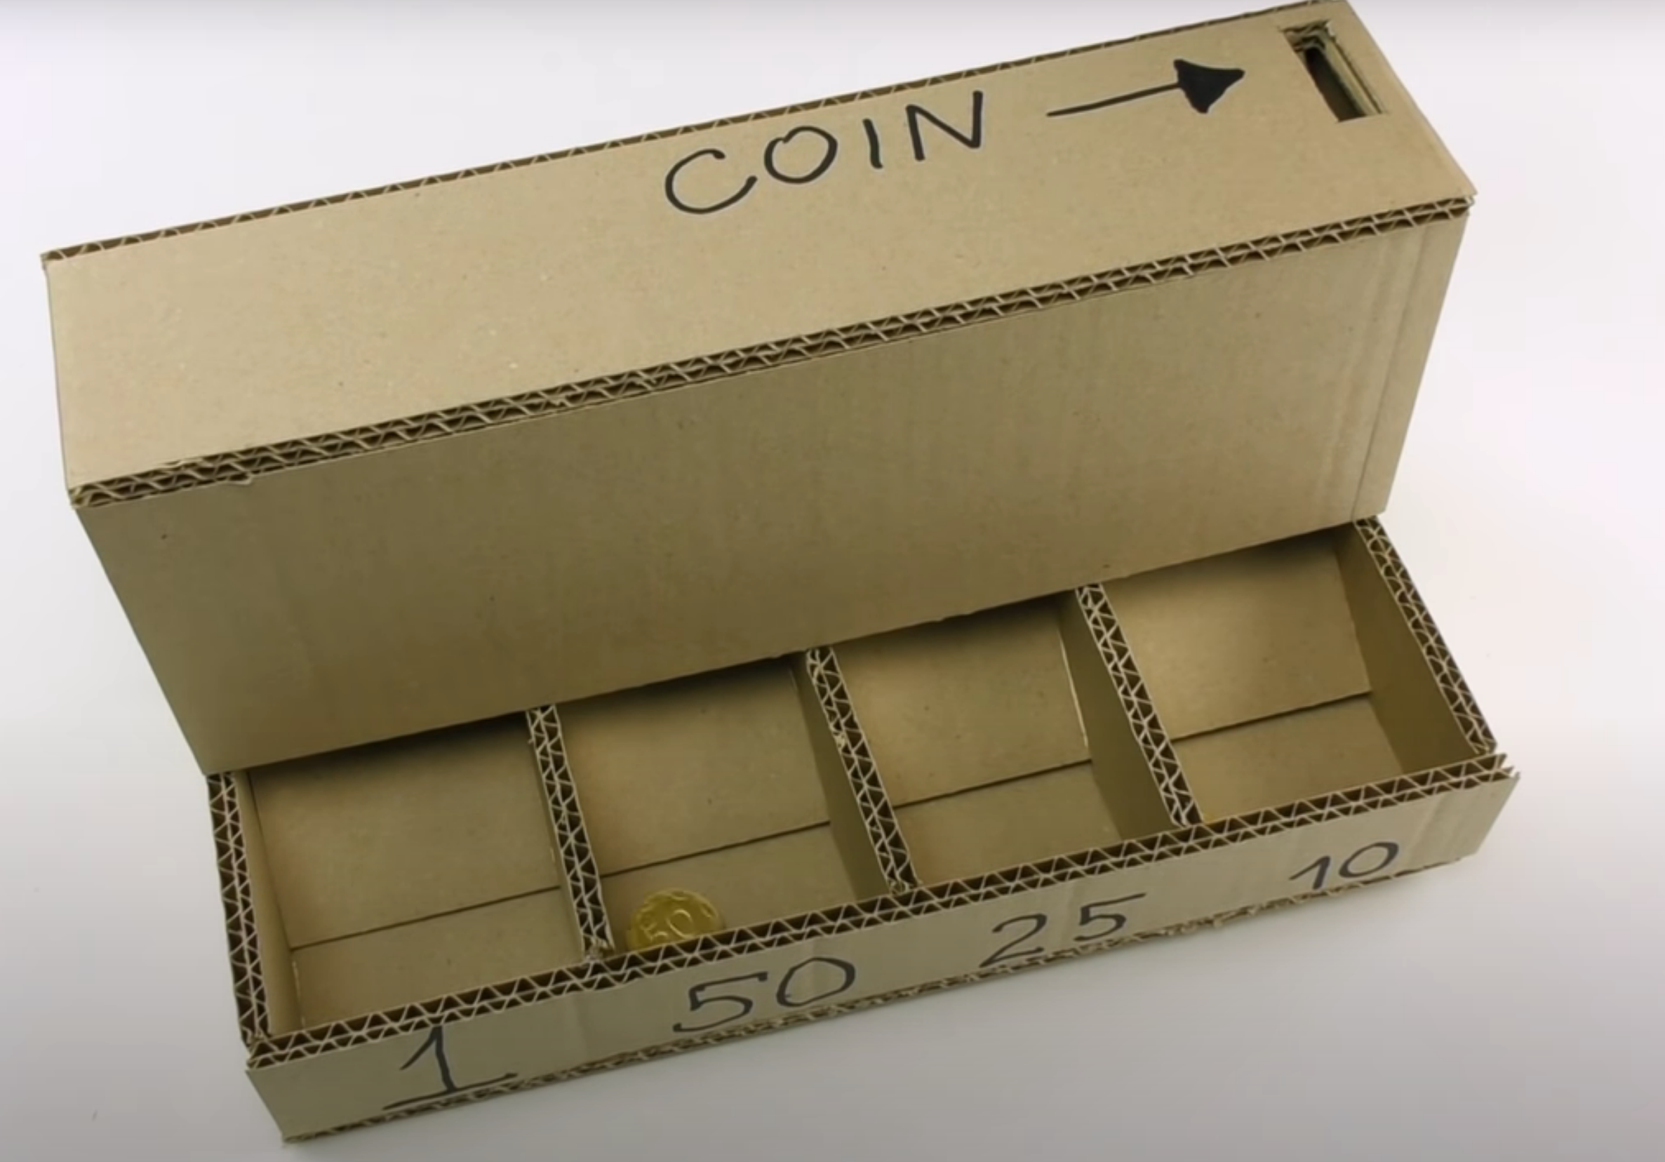
Part 1
Post a picture or video of your design. Add labels to help explain what you made. Make sure to list the four materials you used to make your design.

Slide 2
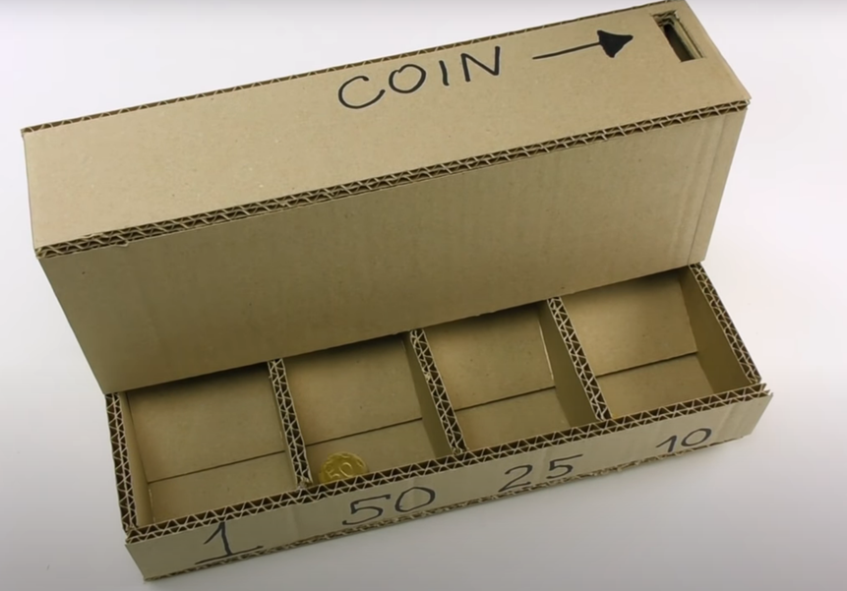
Part 2
Show five different ways you were able to use math with your project.
1 3/4 in.
9 in.

Slide 3
Part 3
Create a word problem based on your object for others to solve.
Bob Loblaw measures the top of the coin box and found it measures 9 in. by 1 ¾ in. What is the area of the section?
What would the area be if he wanted to make the shape 3 times as large? What would the area be if he only wanted to make the width 3 times as large? What would the area be if he made both the length and the width 3 times as large?
What would these changes do to the other sections of the box? Estimate the new length width and area of at least two other parts of the box based on these changes.
If Bob wanted to draw a diagram of his box using the scale of ½ what would the new dimensions of all your sections be? When you have all your new measurements draw a scale diagram of the sections you estimated.

