Slide 1
K/1 PEP ACTIVITIES
4/20-4/24

Slide 2
I LIKE
Mr Gilderdale was thinking of a number rule. He asked the class to choose numbers to test so they could try to work out what the rule was.
If the number they chose fitted his rule, he wrote it on the board under 'I like these numbers'. If the number they chose didn't fit his rule, he wrote it under 'I don't like these numbers'.
After the class had chosen four numbers, this is what was on the board:
What could Mr Gilderdale's rule be?
If you were in Mr Gilderdale's class, which number would you choose next to test your idea? Why?
How could you find out Mr Gilderdale's rule in the smallest number of guesses?
I LIKE THESE NUMBERS | I DON’T LIKE THESE NUMBERS
15 5 | 18 22

Slide 3
OPTIONAL READING ACTIVITY
Go to https://www.getepic.com/ and sign up for your free account. I have posted your first activity which is to read the story My Even Day with your family and then complete quiz for the story. When you are done post a video or a note to Seesaw explaining how this book connects to our math activity for the week.

Slide 4
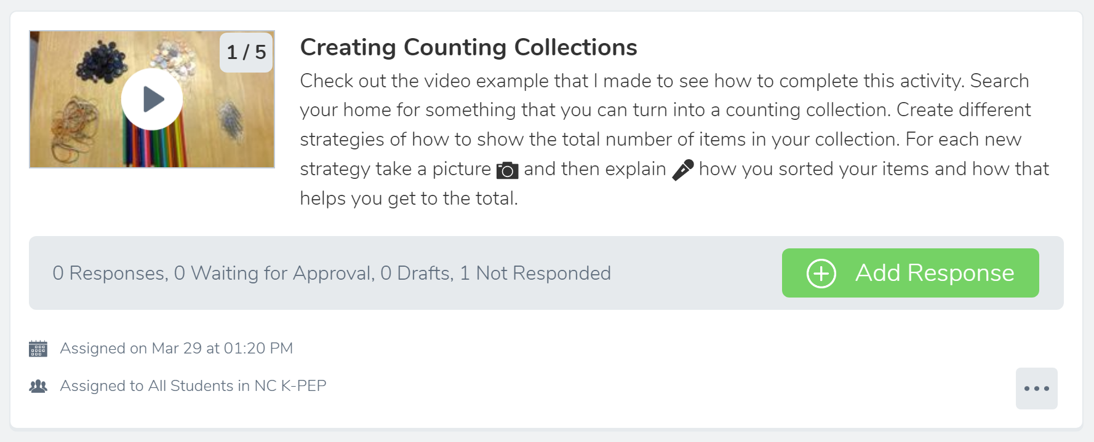
OPTIONAL MATH ACTIVITY
Complete the Creating Counting Collections activity on Seesaw.

